Slide 1

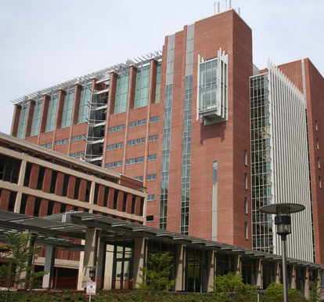
Baltimore, Maryland

Slide 2
Admissions:
Required Courses:
  Biology + labs
  Chemistry + labs
  Ochem + labs
  Physics + labs
  English (6 credits)
  Biochemistry
Recommended
  Upper level biology credits
  Manual dexterity skills
  Research experience
  Arts, humanities, etc
Community College
  60 credit maximum
Minimum Scores
  3.2 GPA
  18 DAT in each section
Committee Letter
Residency
~130 seats

Slide 3
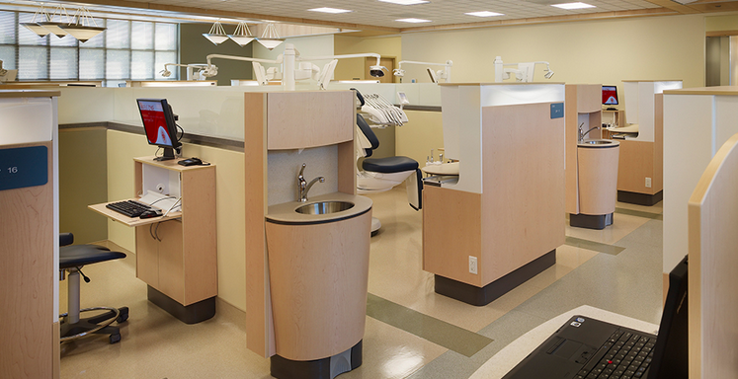
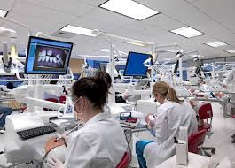
Admission Statistics (from 2011)
2819 Applied
  130 enrolled
Out of State
  2618 Applied
    60 enrolled
GPA (sGPA/cGPA)
  (3.5/3.6)
DAT (AA/PAT)
  (20/20)

Slide 4
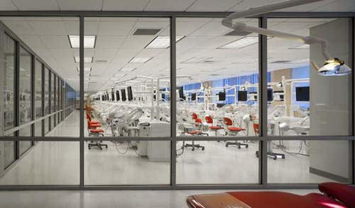
Curriculum
Centered around…
  Biomedical Sciences
    Separate biomedical faculty
  Clinical Sciences
  Research
Online learning
Students Practices
Wide range of post graduate options!
Degree options:
  DDS/ MPH
  DDS MSCR
  DDS/ PhD

Slide 5
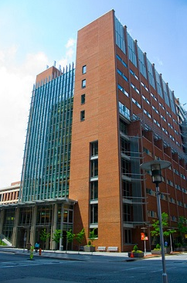
Tuition and Fees
Tuition Only
  Resident: $33,692
  Non-Resident: $62,612
COA-
  $383,796
Financial aid is helpful!
  First year loan amount is $95-98k

Slide 6
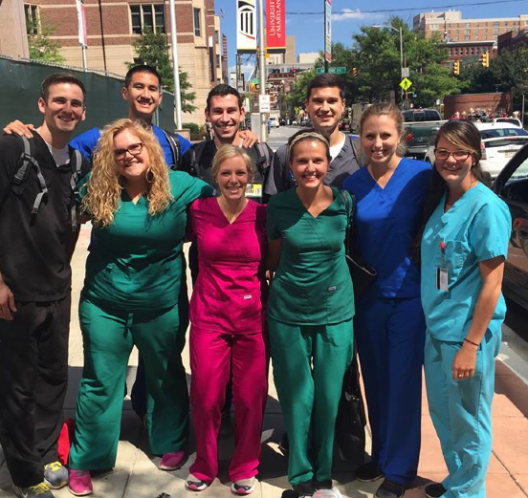
What students think:
13 classes but not too bad!
Google calendar
Tests are scheduled around each other
“Big” assigned- D2
Pass/Fail and A-F classes
Faculty are really helpful!
No dent-sim but mannequins are checked by faculty
Fun activities: Bars, crab feasts, beer Olympics, and tons of stuff always happening
Organizations are stresses
Good patient base

