Slide 1
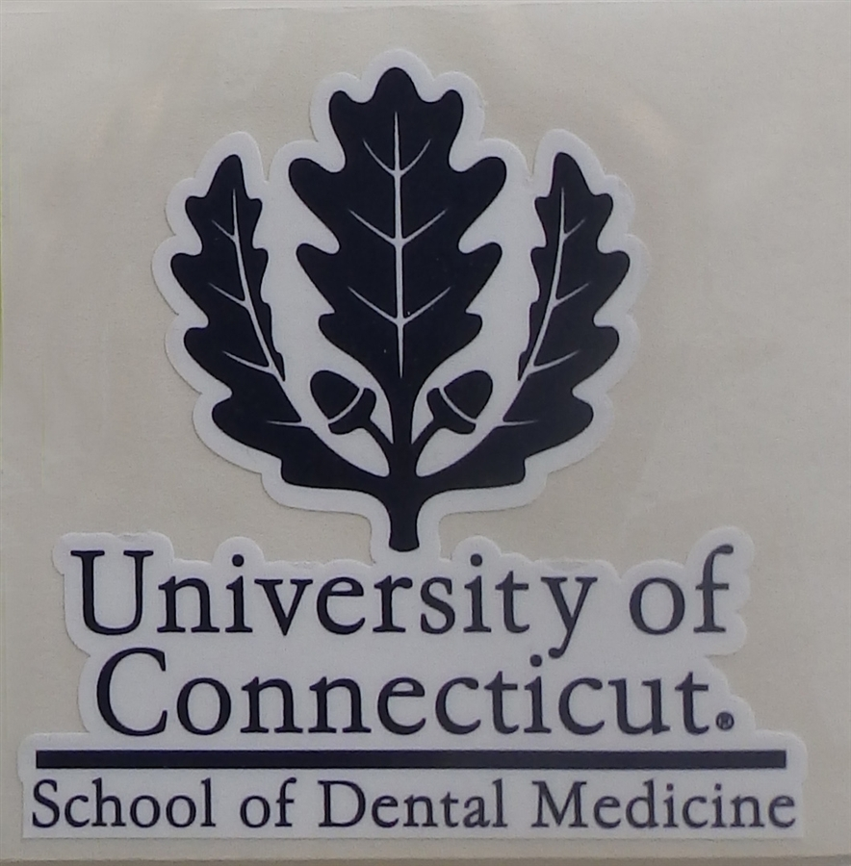
University of Connecticut
School of Dental medicine
Farmington, Connecticut

Slide 2
Admissions
Course Work
  “Overall strength of pre-dental academic record”
  Standard pre-requisites are assumed
AP/IB credit is okay
Community college okay → consider rigor
Committee letter required
Interviews
  All day
  Includes tour, lunch
  1-on-1 interview with clinical or basic science faculty
Evaluation:
  Overall strength of the predental academic record
  Scores on the DAT
  Personal statement
  Commitment to learning
  Motivation for seeking a career in dentistry
  General impressions formed at the interview
  Quality and objectivity of references

Slide 3
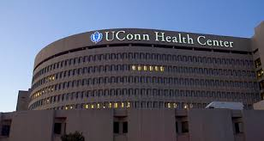
Admission statistics
“Minimum scores are established each year”
2011 Statistics
  20 AA, 19 PAT
  3.62 cGPA
  3.54 sGPA
  Current statistics will be higher!
45 Total Seats!
  ~1300 OOS Applicants
  ~130 OOS Interviewed
  ~30 OOS Accepted
  ~20 OOS Enrolled

Slide 4
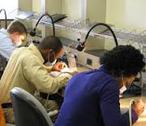
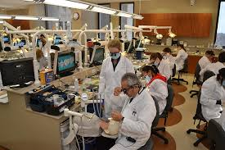
CURRICULUM
Medical Based Curriculum
  #1 for Basic Science Hours!
    2,100 Basic Science Hours
  BUT- Top 1/3 for Clinical Hours
    #1- 6,400 Instructional Hours
  “We hand you over to the medical school but bring every now and then you back to remind you that you’re in dental school.”
47 out of 47 students (C/O 2013) received their first choice residency!
Students always get their first or second choice residency

Slide 5
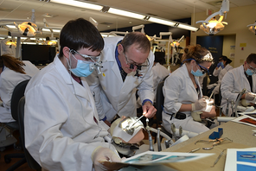
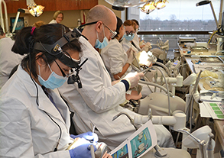
Curriculum Continued
Hospital Based and General Practice Based Model
  50 Comprehensive Care Cases
  900 Total Patient Visits
Begin in clinic during your third year.
Patients bussed in from Hartford
  More suburban patience
Pass/Fail Curriculum
Clinical Grading is based on 32 competencies
As of 2008, 35 Alumni are in Major Academic or Research Positions (Deans, Research Directors, etc)

Slide 6
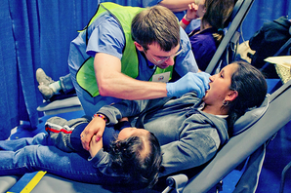
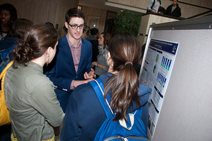
Cool Programs!
Research/Medical Based Curriculum
Summer Research Opportunities with Stipends!
Combined Degrees
  DMD/PhD
  DMD/MPH
  DMD/MSCR
Partnerships:
  17 Community Clinics
  MOM Projects and Free Clinics

Slide 7
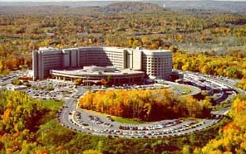


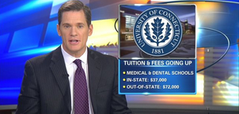
Tuition and Fees
Tuition Only:
Total Cost of Attendance:

Slide 8
Questions?
No known VT Alumni ☹

