Slide 1
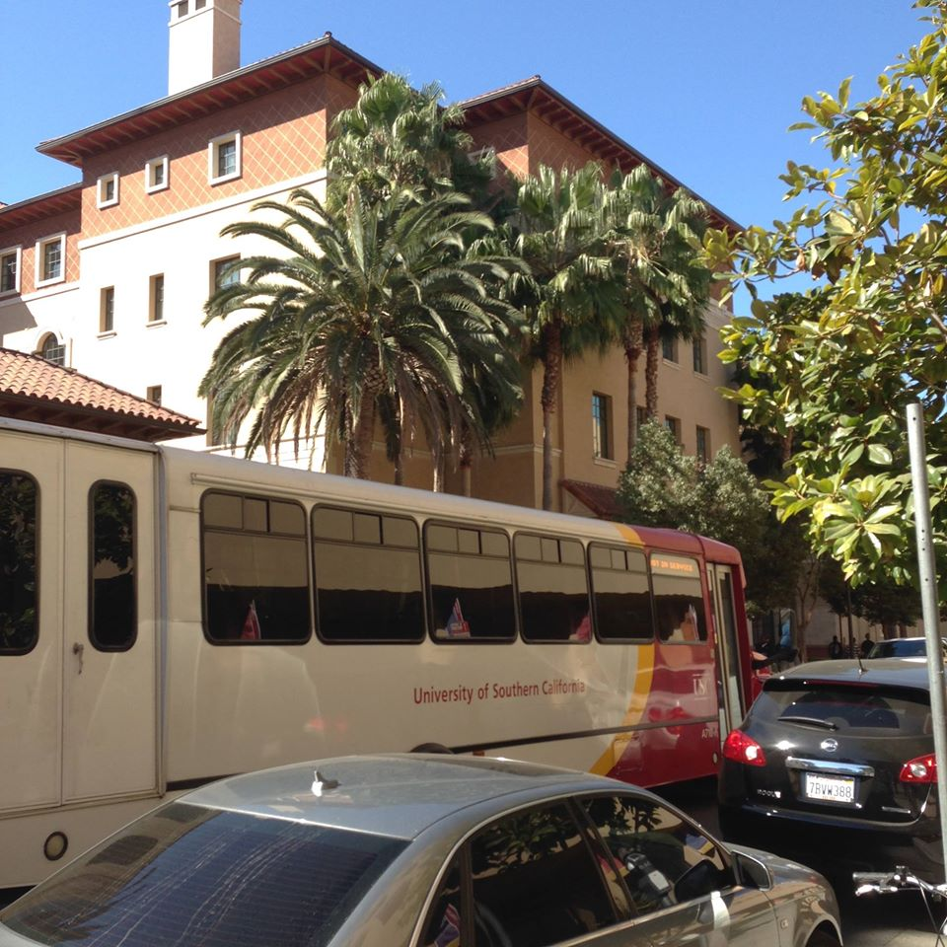


Slide 2
Statistics
Average DAT (AA/TS/PAT): 20/20/20
Average GPA: sGPA (3.4) / oGPA (3.5)

Slide 3
Chances
3329 Applicants
608 offered interview
279 offered admission
144 students matriculate

Slide 4
Requirements
2 semesters Biology & Lab
2 semesters Gen Chem & Lab
2 semesters Organic chem & Lab
2 semesters Physics & Lab
2 semesters English
2 Semesters of philosophy, fine arts, or history
  *waived if receiving BS degree
Recommended:
  Anatomy
  Biochemistry
  Cell Biology
  Histology
  Immunology
  Molecular Bio
  Genetics
Additional Requirements:
  $80 Fee
  Secondary app (If offered interview)

Slide 5
Curriculum
Tuition: $427,000 (Private) -Unique payback plan with the state of California
Problem Based Learning (practice PBL during interview)
Boards taken after second year
Tests are only midterms and finals for D1 & D2
New Electric Hand pieces installed
On Undergraduate campus
“Easier than my undergraduate course load” – USC student interviewer

