Slide 1
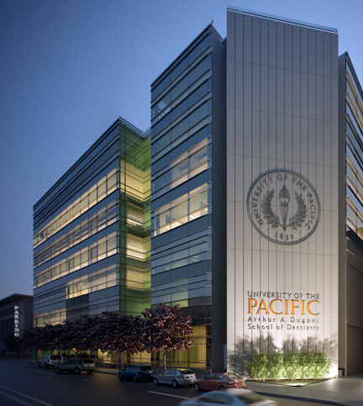


Slide 2
Statistics
Average DAT (AA/TS/PAT): 21/21/21
Average GPA: sGPA (3.4) / oGPA (3.4)

Slide 3
Chances
3016 Applicants (65% Out of State)
298 offered interview (33% OOS)
292 offered admission (33% OOS)
141 students matriculate (25% OOS)

Slide 4
Requirements
Recommended:
  Anatomy/Physiology
  Histology
  Microbiology
  Cell Biology
  Immunology
  Molecular Bio
  Genetics
  Biochemistry
4 semesters Biology & Lab
2 semesters Gen Chem & Lab
2 semesters Organic chem (Lab not required)
2 semesters Physics & Lab
2 semesters English
Additional Requirements:
  $75 Fee
  No secondary app

Slide 5
Curriculum
Tuition: $403,000 (Private)
Only three year program in the country
Block Schedule Exams
Boards taken middle of second year
High specialization rate (Endo, OMFS, etc)
Most highly regarded clinical program in the country
Brand new school and clinic in the middle of downtown San Francisco

