Slide 1
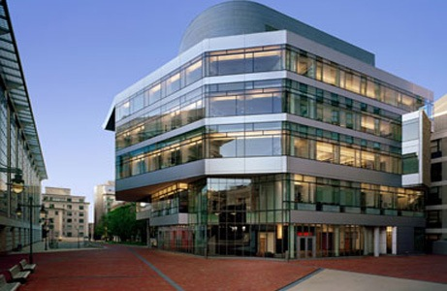


Slide 2
Statistics
Average DAT (AA/TS/PAT): 23/23/22
  Ranges AA/TS/PAT: (20-25)/(20-29)/(19-26)
Average GPA: 3.8 (science)/ 3.8 (overall)
  Ranges sGPA/oGPA: (3.3-4.0)/(3.5-4.2)

Slide 3
Chances
1000 Applicants
  100 offered an interview (10%)
  50 offered admissions (50% of those interviewed)
  35 total matriculants per class

Slide 4
Requirements
2 semesters Biology & Lab
2 semesters Gen Chem & Lab
2 semesters Organic chem & Lab
2 semesters Physics & Lab
2 semesters Calculus
2 semesters English
1 semester of Biochemistry
Recommended:
  Cell Biology
  Microbiology
  Physiology
  Biostats
  Undergraduate Research
Additional Requirements:
  $75 Fee mailed
  Supplemental App if invited

Slide 5
Curriculum
Tuition: $364,000 (Private)
First two years with Harvard Medical School
Mandatory Research Project
Boards taken after second year (highest scores in the country consistently)
Block Exam Schedule
Pass/Fail
100% specialization rate

