Slide 1
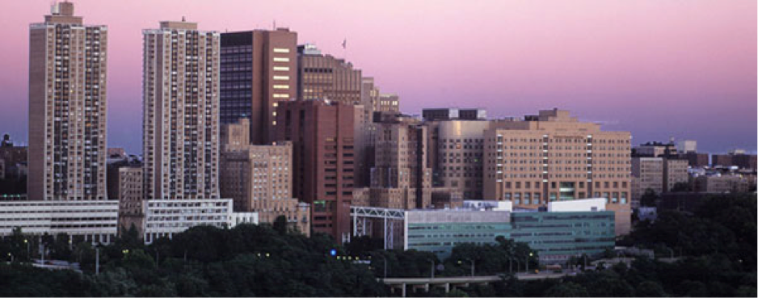


Slide 2
Statistics
Average DAT (AA/TS/PAT): 22.4/23/21
Average GPA: sGPA (3.5) / oGPA (3.5)

Slide 3
Chances
2300 Applicants
  280 offered interview (12%)
    170 offered admission (60% of interviewed)
      80 students matriculate (47% of those accepted)

Slide 4
Requirements
2 semesters Biology & Lab
2 semesters Gen Chem & Lab
2 semesters Organic chem & Lab
2 semesters of Mathematics (prefer calculus)
2 semesters Physics & Lab
2 semesters English
1 semester of Biochemistry
Recommended:
  Anatomy/Physiology
  Cell Biology
  Sociology
  History
  Fine Arts
  Undergrad Research
Additional Requirements:
  $75 Fee
  No secondary app

Slide 5
Curriculum
Tuition: $378,000 (Private)
First two years with Columbia Medical School
Boards taken after second year
Block Exam Schedule year one/Sporadic Year 2/Clinical last two years
Pass/Fail/Honors
40% specialization rate (Endo, OMFS, etc
  95% if including AEGD, GPR, etc.

