Slide 1

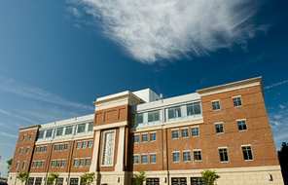
Virginia Commonwealth
Richmond, Virginia

Slide 2
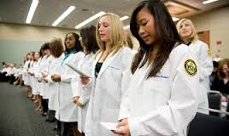
Admissions
Required Courses:
  Biology + labs
  Chemistry + labs
  Ochem + labs
  Physics + labs
  English (6 credits)
  Biochemistry
  Math/Stats (6 credits)
Recommended:
  3000/4000 level biology
  Behavioral Sciences
  Courses involving dexterity
Community College
  Up to 60 credits*
AP/IB/Duel Enrollment
Committee Letter
100-150 hours of shadowing
~100 seats
Residency

Slide 3
Admissions Statistics (2011):
GPA (cGPA/sGPA):
  (3.5/3.44)
DAT (AA/PAT)
  (19/20)
  Class of 2019= 20.4!\
Average age: 25
Applied: 2551
  Enrolled: 100
In-state
  Applied: 283
  Interviewed: 101
  Accepted: 66

Slide 4
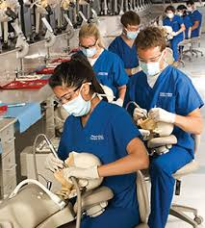
Curriculum:
Basic science, behavioral science, and clinical science
A-F Grading
First weeks at VCU
  Gross and neuro anatomy
  Dental anatomy and operative dentistry
  Microbiology/ immunology is coming
  Psych in winter
Early clinical exposure
Boards after your first year
Some research.

Slide 5

Tuition and Fees:
Tuition Only (D1):
  $33,610 IS
  $59,224 OOS
COA- $264,018
Helpful financial aid
Some scholarships available (merit-based)

Slide 6
What Students Think:
The students are the opposite of competitive.
Professors are extremely helpful and want to see each student succeed.
They make a point to learn names
Tons of festivals, farmers markets, awesome restaurants, shopping near by in Short Pump and Carytown
Lots of bars and restaurants nearby
Kayaking, swimming, hiking at the river and nearby in Lake Anna
Muesems for everything
Redskins training camp and minor league baseball team
Lots of decent housing in shockoe bottom or the fan. ~$800 per month
Austin Moon
Ashley Pater
Mahesh Yalamanchili
David Abeyounis
Nicole Rodgers
Kayla Roe
Karoline Seekford
And so many more…

