Slide 1
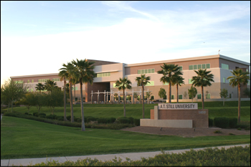


Slide 2
Statistics
Average DAT (AA/TS/PAT): 18.6/18.6/20
Average GPA: sGPA (3.2) / oGPA (3.4)

Slide 3
Chances
3543 Applicants
380 offered interview
127 offered admission
76 students matriculate

Slide 4
Requirements
2 semesters Biology & Lab
2 semesters Gen Chem & Lab
2 semesters Organic chem & Lab
1 Semester Physiology
2 semesters Physics & Lab
1 Semester Anatomy
1 semester of Biochemistry
Recommended:
1 semester Microbiology
Additional Requirements:
  $70 Fee
  Secondary app

Slide 5
Curriculum
Tuition: $400,000 (Private)
D.M.D Granted
Located in Tucson, Arizona
Average accepted applicant has 800+ hours of volunteer work
Volunteer work is equal in weight to GPA & DAT
Exams are spread weekly with traditional Midterms and Finals
4th Years required to do dental externship for 5-6 months
Boards taken after 1st year

