Slide 1

“Knowledge that will
change your world”
University of Alabama, School of Dentistry
Birmingham, Alabama
Spotlight Dental School, Pre-Dental Club at Virginia Tech
Craig McKenzie 2016

Slide 2
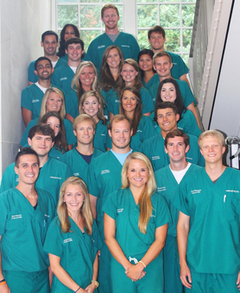
Pre-Reqs
  Biology (12 credits)
    General Biology required
    Anatomy, cell biology, histology, microbiology
  Gen Chem (8 credits)
  Ochem (8 credits)
  Physics (8 credits)
  Mathmatics (6 credits)
    Analytical geometry or Calculus
  Non-Science (30 credits)
Notes:
----- Meeting Notes (3/15/16 19:11) -----

Slide 3
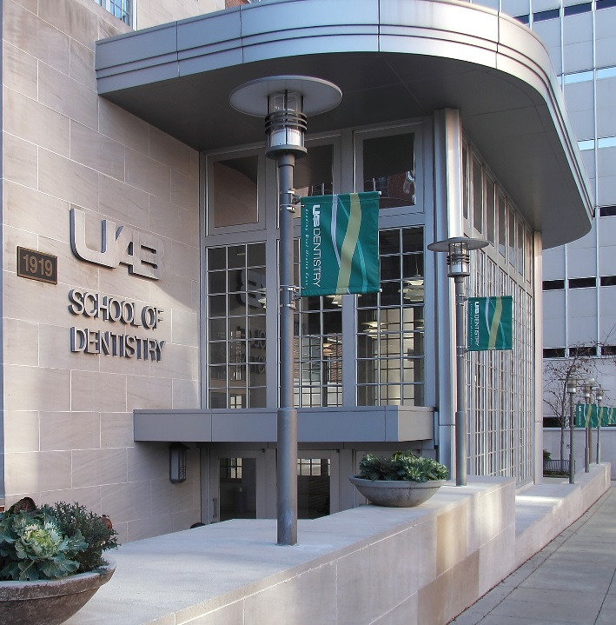
Admission’s Statistics
DAT
  AA: 20
  TS: 20
  PAT: 20
GPA
  Science: 3.6
  Overall: 3.7
Number of Students
  60 total
  15 out-of-state

Slide 4

Tuition and Fees
In-State
Out-of-State
Tuition: $107,740
Fees: $14,795
Books: $10,000
Equipment: $22,673
Living Expenses*: $96,000
Total- $251,308
Tuition: $249,575
Fees: $14,795
Books: $10,000
Equipment: $22,673
Living Expenses*: $96,000
Total- $393,143

Slide 5




World Class Faculty

Slide 6

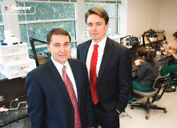
Curriculum
Systems-Based Sciences
Comprehensive Care Model
Combined PhD Program
Extramural Rotations
Research Project

Slide 7
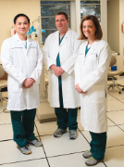
Curriculum
Year 1:
  Assist in Clinic
  Basic Sciences, Pre-Clinic
Year 2:
  Practice Hygiene
  Basic Sciences, Pre-Clinic
  Simple Restorative Procedures
Year 3:
  “Dentist” in Clinic
Year 4:
  Continue in Clinic
  Elective Rotations

Slide 8
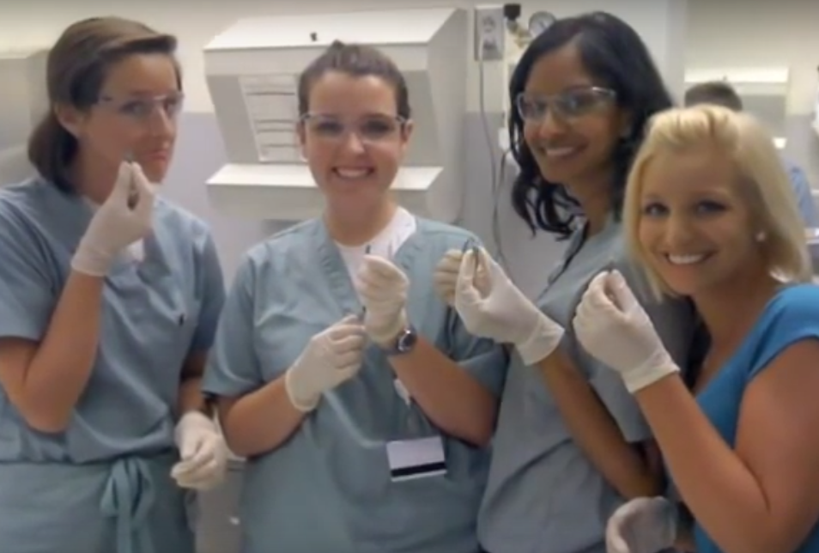

Why Alabama??
Top Funded Research Program
Passing Board
Strong Clinics
  68 Crowns!
Amazing Facilities
More Chairs than Students
So Many Patients!

Slide 9
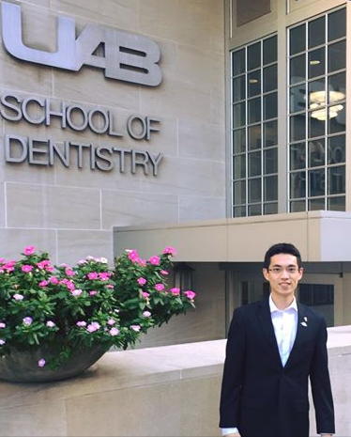
What (future) Students Like:
Smaller Class Size
Significant Scholarships
Strong Clinical Program
Faculty is Very Friendly
Located on Medical Campus
Not Cut-Throat
Many Specialty Clinics

