Slide 1

Kornberg School of dentistry
Spotlight dental School
Source: Craig McKenzie 2016, Predental Club at Virginia tech

Slide 2
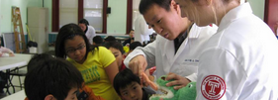
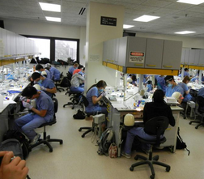
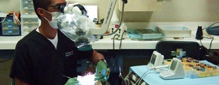
Mission of temple
“students' needs and
concerns are top priority”
“manual dexterity, diagnostic and clinical skills and a sound understanding of the business aspects”
“committed to clinical excellence”
Notes:
Admissions Interim Dean’s message

Slide 3
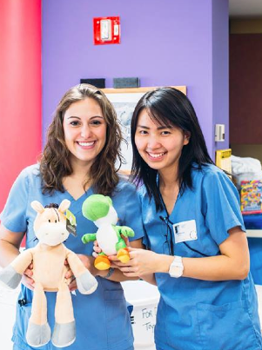
Pre-Requisite Courses
Required
  Biology (8 cr)
  Inorganic (gen) Chemistry (8 cr)
  Organic Chemistry (8 cr)
  Physics (8 cr)
  English (6 cr)
Recommended:
  Advanced science courses
  Biochemistry, anatomy/physiology, histology

Slide 4

Class characteristics
In 2014-2015 cycle:
Class of 140
  3591 applied
69 female
64 Out of State*
3.5 Mean GPA
20 AA DAT
20 TS DAT

Slide 5
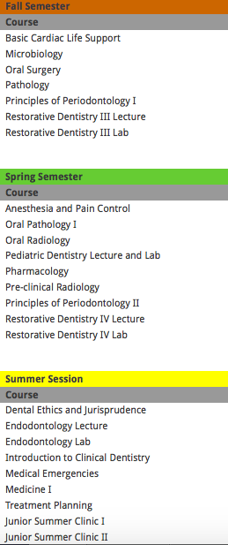
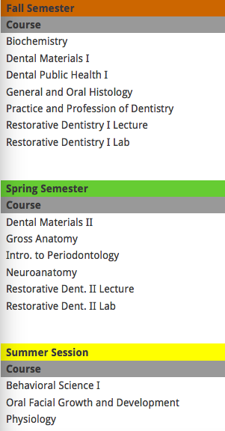
Curriculum
Year one
Year two
Notes:
First year: covering basic sciences and anatomy. Beginning exposure to clinic through assisting
Second Year: really rigorous pre-clinical years. Lots of practice so that by the time they get into clinic the students feel confident working with their hands.

Slide 6
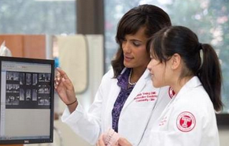
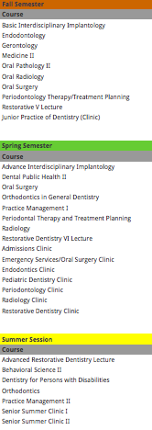
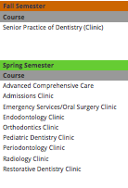
curriculum
Year three
Year four
Notes:
Third year: Start full time in clinics with some exposure to specialties. Although, they prefer you to get most expose to specialties on your own time. Temples goal though is to create fully competent general dentists though, so most of your time on clinic is spent on working towards that. Students are divided into 4 clusters with equal GPA balance.

Slide 7

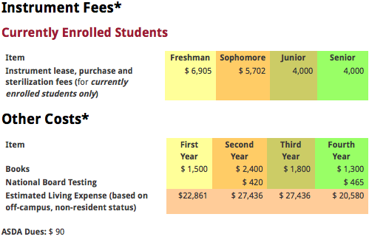
Tuition and fees
Tuition only
  59,512 OOS
  51,308 IS
Total COA
  365,213
Fees:

Slide 8
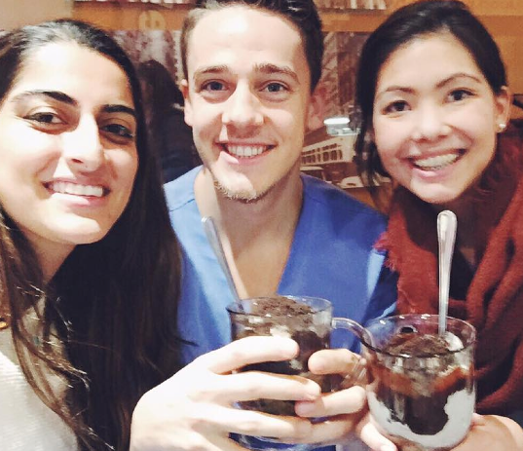
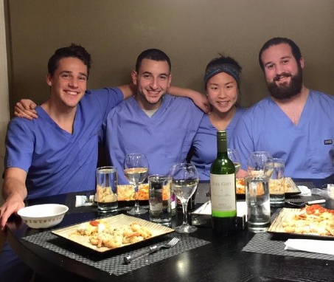
What students have to say:
Tough competition if you’re trying to specialize
Study groups
Work in four practice groups
Confidence upon graduation
Supportive faculty
Larger class= lots of different people
  Ski Trips
  “Going out”
Moving towards research focus
  New! Mandatory research project

Slide 9
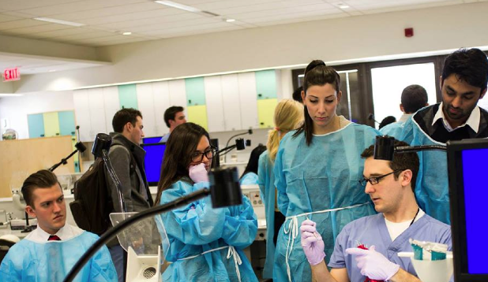
Pre-dental day 2016!
Who: Pre-Dental Students!
What: SO MUCH FUN!
Raffles! (I love raffles ☺)
“How Dentistry and Medicine Relate”
Kaplan Presentation
“What are the Benefits of ASDA”
School Tour
Pre-Clinical Activities
When: Friday, February 19, 2016
10:00am to 5:00pm
Where: Kornberg School of Dentistry
How much?: $45 per person (incl. lunch)
Sign up: Here
Pre-Dental Day Video

Slide 10
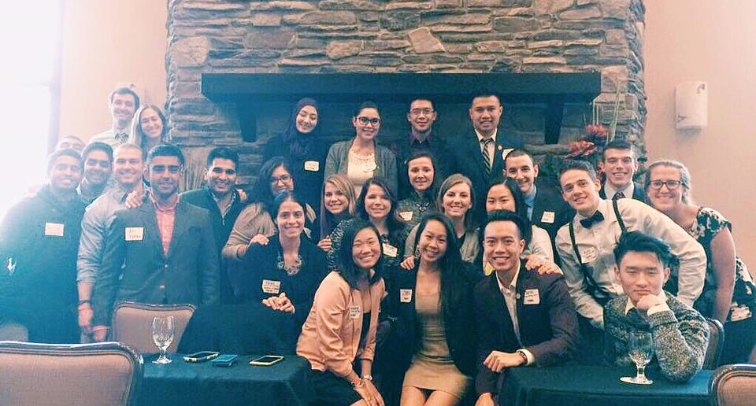
Questions?
ASDA Pre-Dental Chair- Steve McCown
tuf69016@temple.edu

