Slide 1
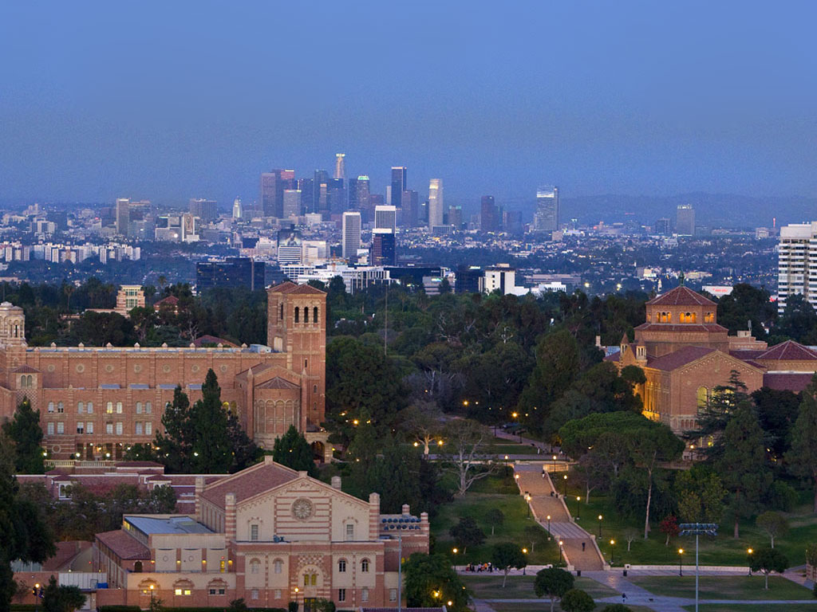


Slide 2
Statistics
Average DAT (AA/TS/PAT): 22/22/22
Average GPA: sGPA (3.6) / oGPA (3.7)

Slide 3
Chances
1771 Applicants (46% Out of State)
132 offered interview (14% OOS)
120 offered admission (10% OOS)
88 students matriculate (9% OOS)

Slide 4
Requirements
2 semesters Biology & Lab
2 semesters Gen Chem & Lab
2 semesters Organic chem (Lab not required)
1 semester of Psychology
2 semesters Physics & Lab
2 semesters English
1 semester of Biochemistry
Recommended:
  Anatomy/Physiology
  Histology
  Microbiology
  Undergrad Research
Additional Requirements:
  $60 Fee
  secondary app

Slide 5
Curriculum
Tuition: $342,000 Out of State (Public)
  average OOS receives $60k in scholarship
Midterms & Finals only per quarter
Boards taken after second year
Pass/Fail/Honors
High specialization rate (Endo, OMFS, etc)
PhD/DDS program available
95% of class receives some scholarship towards tuition

