Slide 1
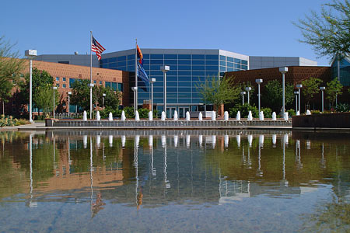
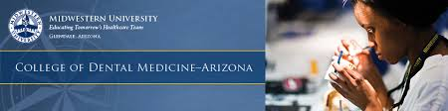

Slide 2
Statistics
Average DAT (AA/TS/PAT): 19/19/20
Average GPA: sGPA (3.5) / oGPA (3.6)

Slide 3
Chances
2967 Applicants
489 offered interview
297 offered admission
140 students matriculate

Slide 4
Requirements
2 semesters Biology & Lab
2 semesters Gen Chem & Lab
2 semesters Organic chem & Lab
2 semesters Physics & Lab
2 semesters English
1 Semester Anatomy & Physiology w/ Lab
1semester Microbiology
1semester Biochemistry
Recommended:
  Histology
  Immunology
  Molecular Bio
  Genetics
  Zoology
Additional Requirements:
  $50 Fee
  Secondary app on
  custom mobile portal

Slide 5
Curriculum
Tuition: $400,000 (Private) – 5% increase in tuition each year
Boards taken after first year
Exams are weekly spaced with typical midterms and finals
3rd years assist 4th years
Systems based learning i.e. jaw 1 week, molars 1 week, etc.
No Departments only general dentistry
Most crowns, filling, other procedures performed per dental student prior to graduation of any dental school

