Slide 1
CHIPOTLE!!!
  Sunday from 5-10
  New Chipotle near Empo!!
  POINT FOR COMING!!!
    Extra Chance to ~WIN~ goodies!! Crest 3D White and Oral B brushing kit

Slide 2
DAT Workshop
Everything you need to know!

Slide 3
What is the DAT?
The Dental Admissions Test is a standardized test conducted by the American Dental Association as “ a means to assess an applicants’ potential for success.”
Required by all schools for admission
http://www.ada.org/~/media/ADA/Education%20and%20Careers/Files/dat_examinee_guide.pdf?la=en

Slide 4
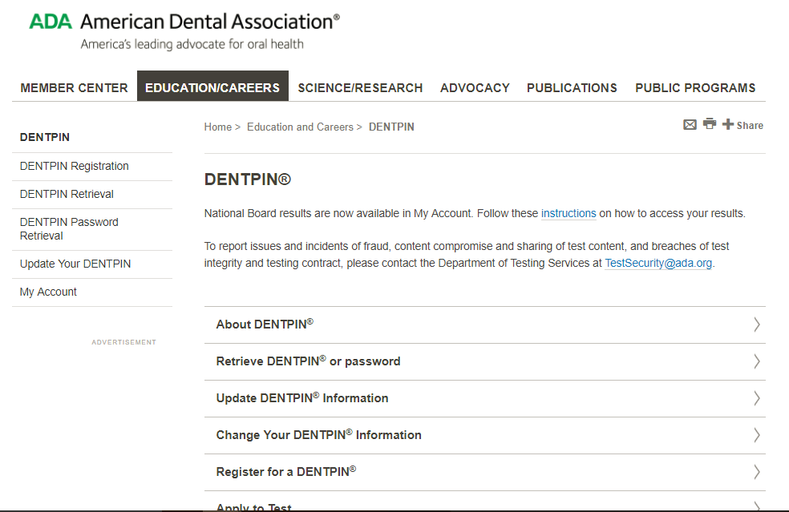
Apply for the DAT: Step One
Obtain DENTPIN (http://www.ada.org/en/education-careers/dentpin)
Fill out an application
Do this sooner rather than later, takes
a while to receive

Slide 5
Apply for the DAT: Step Two
After receiving DENTPIN, apply to take the DAT
http://www.ada.org/en/education-careers/dental-admission-test/apply-to-take-the-dat
Fee of $445
  Covers reporting of the score to all dental schools
Apply months in advance! (6 month period to take it)

Slide 6
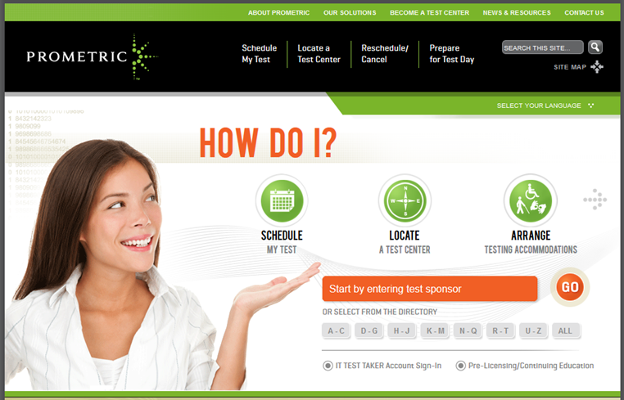
Apply for the DAT: Step Three
Sign up through Prometric Test Center

Slide 7
When Should You Take the DAT?
Definitely after you have taken the courses that you will be tested on
  General Chemistry, Organic Chemistry, General Biology
I suggest to take some upper level Biology classes
  Cell and Molec., Genetics, Microbiology
Summer after Sophomore/Junior Year
Winter Breaks

Slide 8

How is the DAT Scored?
Each section has scores based on number of correct responses (not penalized for guessing!)
Directly compared to other DAT examinees of that day
Neither a percentage of correct responses nor a percentile of that day
ADA has a proven system of scoring that is both “reliable and valid”

Slide 9
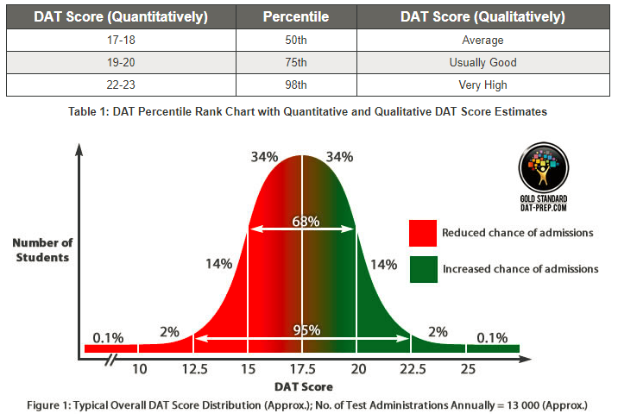
How is the DAT Scored?
Given 6 Scores from 1-30: CHM, ORG, BIO, RC, QR, PAT
  Some might not even go up to 30
Total Science (TS): Sum of raw scores for all
100 Natural Science questions
Academic Average (AA): Average of 5 scores, not PAT
  103 ÷ 5 = 20.6, rounded up to 21
Average is usually 17/18, competitive scores are in
19-21 range

Slide 10
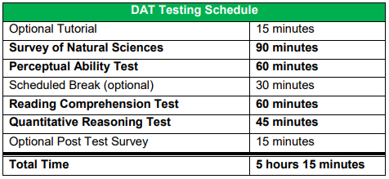
What Subjects are on the DAT?

Slide 11
Optional Tutorial
Shows you how the software works
You can highlight questions and cross answer choices out
Mark questions for review
Review whole section at the end if you still have time
Receive 2 laminated sheets and 2 markers, set your board up!

Slide 12
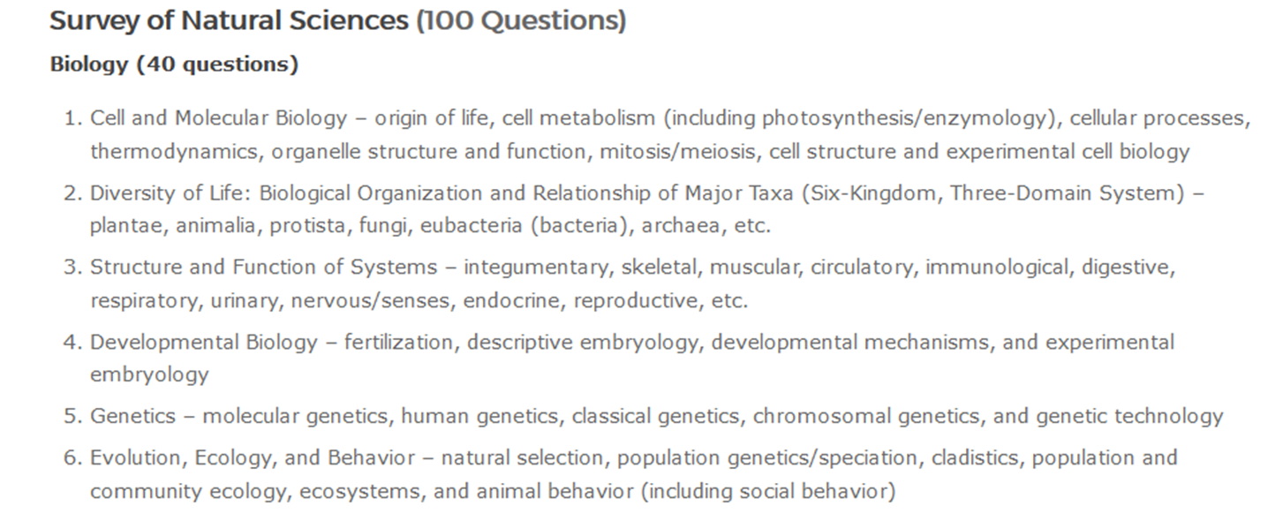
Survey of Natural Sciences
3 Sections: Biology, General Chemistry, and Organic Chemistry
100 Questions in 90 minutes

Slide 13
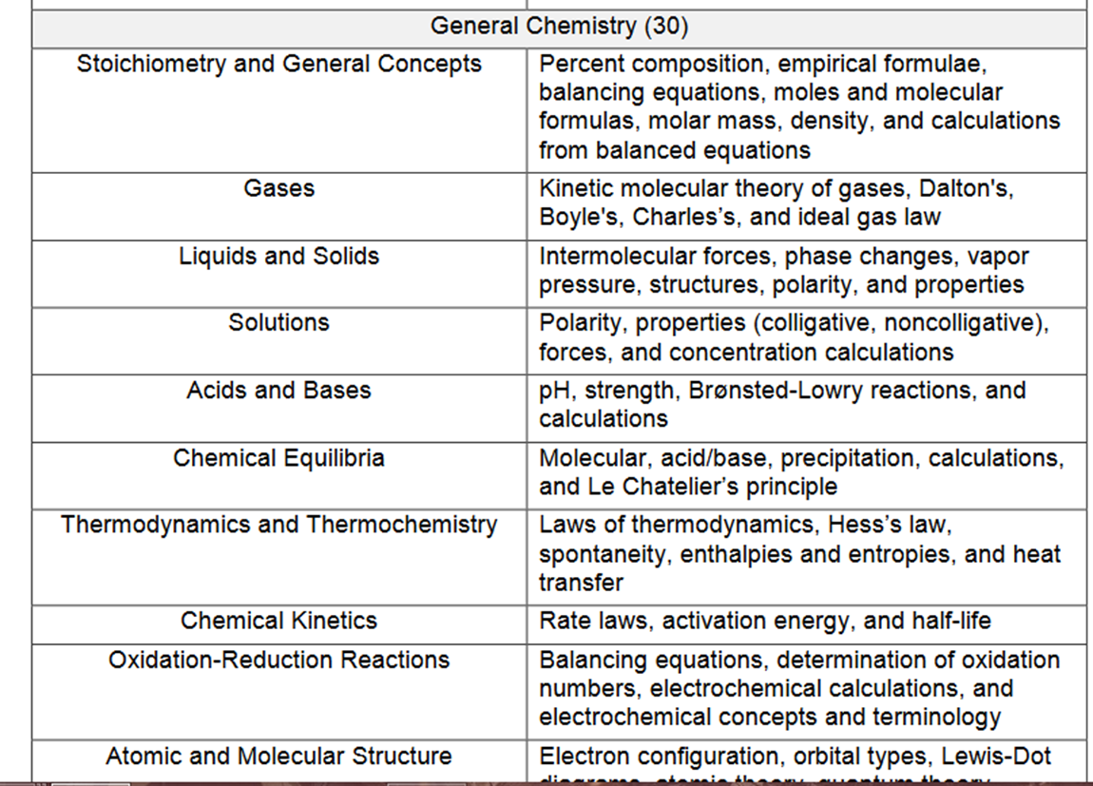
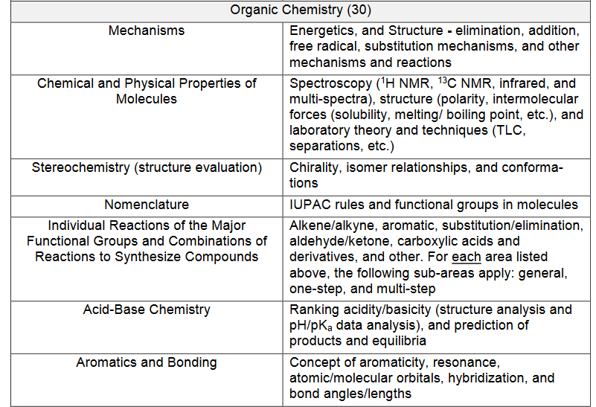
Survey of Natural Sciences Cont.

Slide 14
How to Study for this Section
DAT Bootcamp - $247 for 3 months
  Mikes Videos
  DAT Genius (Practice Tests)
DAT Destroyer - $200 w/ Math Destroyer
Feralis’ Notes & Cliffs AP Bio Notes – FREE
Chad’s Videos (CourseSaver) - $50 for 1 month
CrackDAT and Kaplan

Slide 15
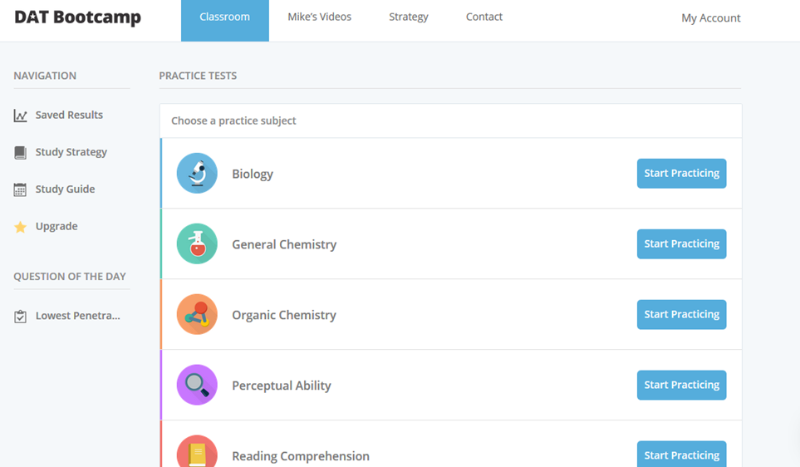
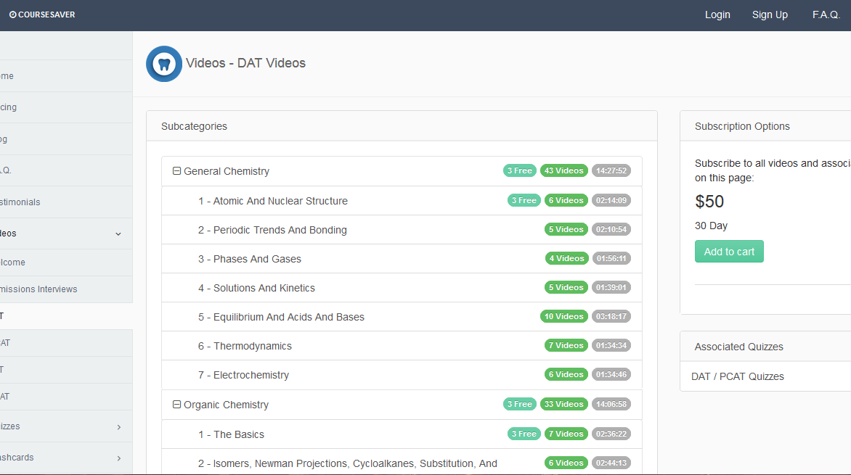
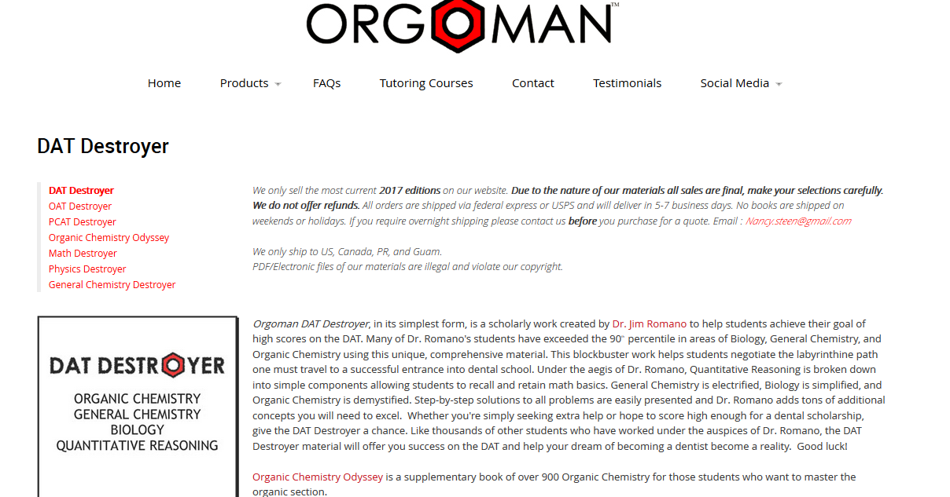
Any Questions

Slide 16

Perceptual Ability (PAT)
6 Sections: Keyhole, Top-Front-End, Angle Ranking, Hole Punching, Cube Counting, Pattern Folding
90 questions in 60 minutes (15 questions per sections)
PRACTICE PRACTICE PRACTICE!
Make your boards before the test begins

Slide 17
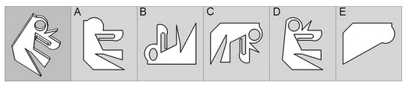
Keyhole

Slide 18
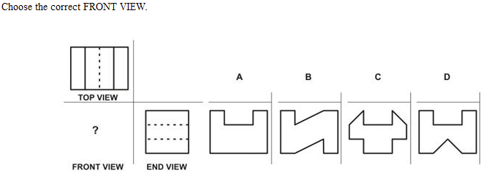
Top Front End

Slide 19
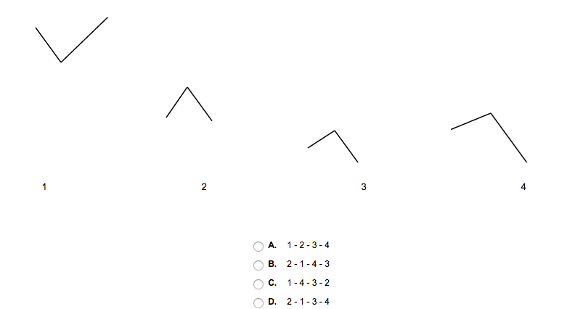
Angle Ranking

Slide 20
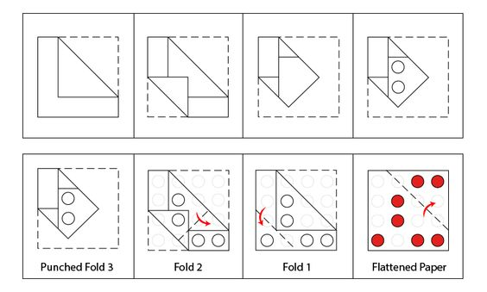
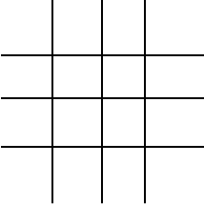
Hole Punching

Slide 21
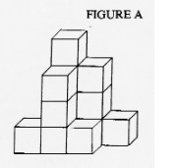
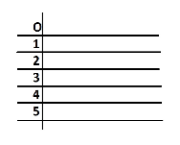
Cube Counting

Slide 22
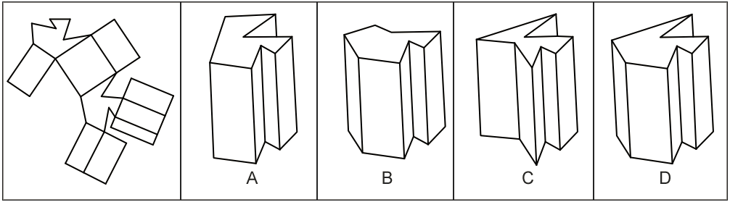
Pattern Folding

Slide 23
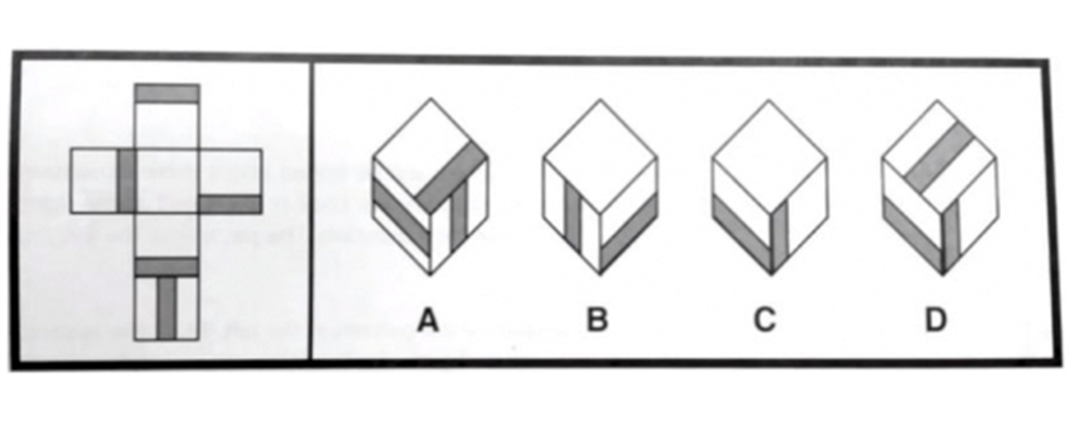
Pattern Folding Cont.

Slide 24
Optional 30 Minute Break
Use this to relax, get some water, eat some food, go to the bathroom, etc.
  I ate my lunch outside, eventually got antsy and went back a little early
Stay focused, do not check your phone
Any more questions?

Slide 25
Reading Comprehension
50 Questions in 60 minutes
3 science-based articles, ~10-18 paragraphs each
How to study:
  Ready science articles daily (Scientific American)
  Practice Tests (DAT Bootcamp, Crack DAT, Kaplan)
Spend 20 min per article. I read to about 7th paragraph, answered as many questions as I could, then read some more.
Use highlighter!

Slide 26
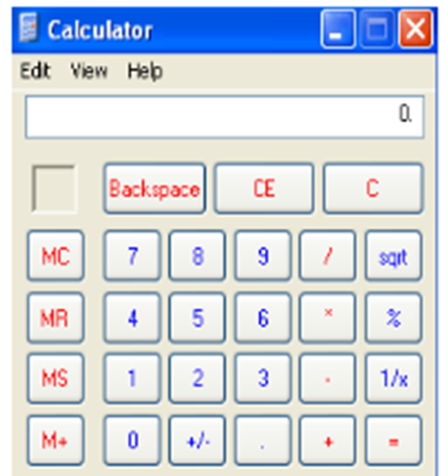
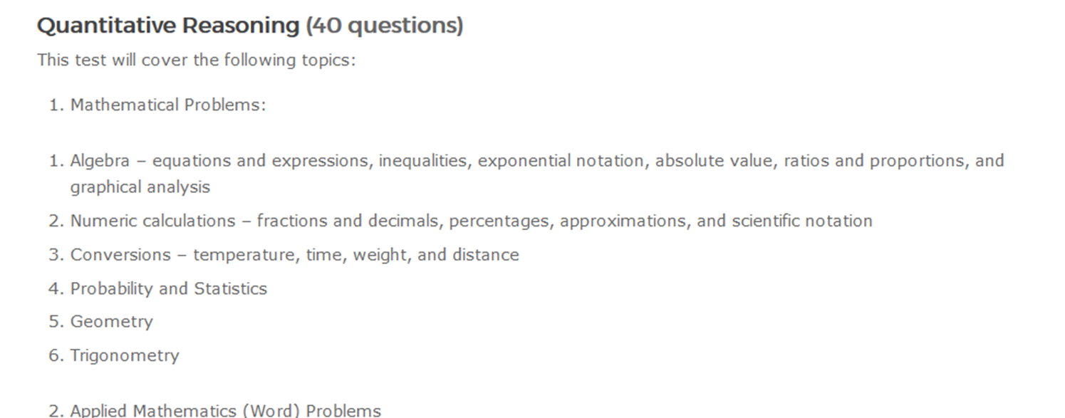
Quantitative Reasoning
40 questions in 45 minutes
Simple calculator, use number pad
How to study:
  DAT Bootcamp, DAT Destroyer
  Khan Academy videos

Slide 27

Your Done!
Option survey at the end about the test and the testing center
Receive score right after you finish…
Get an unofficial copy when you leave
Can request official scores from ADA - $35

Slide 28
My Strategy
Followed Ari’s Study Guide loosely
  Little bit of each subject everyday
Review all materials for the first half, practice the last half
I used only DAT Bootcamp and DAT Destroyer
  Only went through Destroyer once, some people do twice
When you practice, write down what you don’t know to review later
PAT is all about practice, get your timing right
Last week take full length practice tests, treat them legit
Day before test just relax, you’ve earned it (review some notes)

Slide 29
My Advice
Get outside, don’t be a hermit, release stress
Stay focused, it is easy to get distracted
Talk to friends, make a GroupMe of people taking the test
Treat it like a job
Believe in yourself
I took off the weekend before (sister’s wedding) and the day before (saw Spiderman: Homecoming by myself… lol)

Slide 30
My Info
Call or Text me: 703-408-8811
Email: tjw13@vt.edu
Venmo: @TJ-Winkler

Slide 31

Final Questions?

