Slide 1
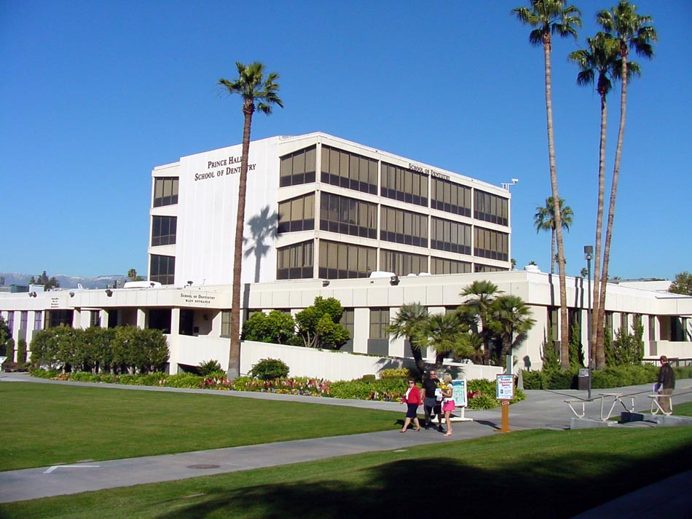
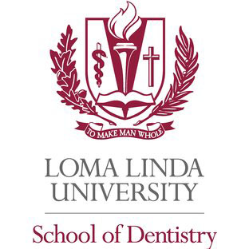

Slide 2
Statistics
Average DAT (AA/TS/PAT): 19.9/19.9/20.7
Average GPA: sGPA (3.2) / oGPA (3.3)

Slide 3
Chances
1967 Applicants
411 offered interview
93 students matriculate

Slide 4
Requirements
Recommended:
  Anatomy/Physiology
  Cell Biology
  Histology
  Immunology
  Microbiology
  Molecular Bio
  Genetics
2 semesters Biology & Lab
2 semesters Gen Chem & Lab
2 semesters Organic chem & Lab
2 semesters Physics & Lab
2 semesters English
1 semester of Biochemistry
Additional Requirements:
  $100 Fee
  Secondary app
  LOR from spiritual leader

Slide 5
Curriculum
Tuition: $385,100 (Private)
Preference given to members of the Church of Latter Day Saints
Boards taken after second year
Block Exam Schedule Pass/Fail/Honors
D.D.S degree granted
Located in San Bernardino-2 hours east of Los Angeles

